Slide 1
Openshift Jenkins CI/CD

Slide 2
OpenShift Pipeline Plugin with External Jenkins
OpenShift provides a Jenkins Container as the CI/CD tool to run on an OpenShift cluster. You can use this tool to set up your CI/CD pipelines in order to deploy applications to an OpenShift cluster or elsewhere.
However, we do come across use cases where there is a need to run Jenkins outside OpenShift and still deploy applications to an OpenShift cluster. For example, some organizations have invested in CI/CD infrastructure that they want to reuse for workloads deployed to OpenShift.
There are a few ways to use an external Jenkins to deploy applications to OpenShift:
You can install an oc command line tool on the external Jenkins server and use oc mechanism to deploy applications to OpenShift.
You can use REST APIs to interact with OpenShift.
You can use OpenShift plugin to deploy applications to OpenShift.

Slide 3
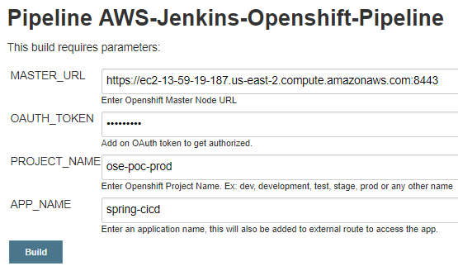
Prerequisites
Before running this example,
Run Jenkins, Nexus & SonarQube locally.
Login into SonarQube & copy the login token & replace it at line 40 of Jenkinsfile
Within Nexus create a snapshot maven2 format asset(this is mapped in the SpringBoot Application pom.xml)
Within Jenkins install the OC CLI Plugin.
Create a Jenkins pipeline with Parameterized Build, (SCM - https://github.com/sidd-harth/openshift-AWS-jenkins.git )

Slide 4
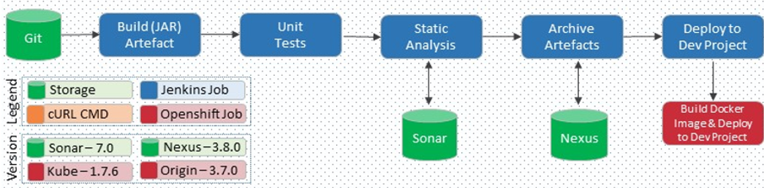
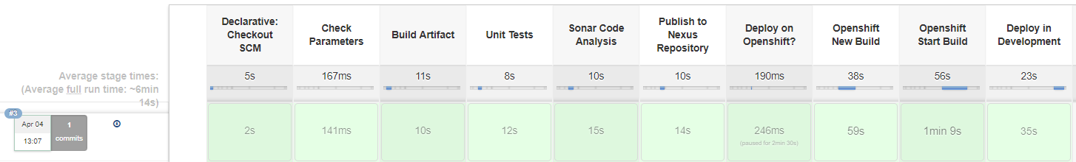
Jenkins CI/CD Pipeline
https://github.com/sidd-harth/openshift-AWS-jenkins.git
https://github.com/sidd-harth/openshift-AWS-jenkins.git
https://github.com/sidd-harth/openshift-AWS-jenkins.git

